Slide 1
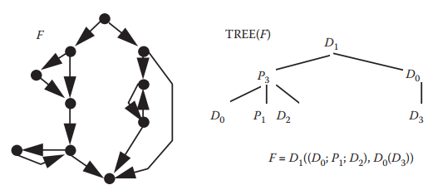
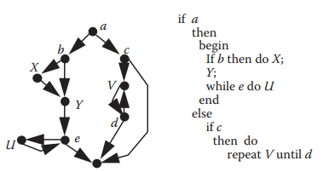
Prime Decomposition Example
Flowgraph to Decomposition tree
Flowgraph to program structure

Slide 2
Prime decomposition
Prime decomposition theorem: Every ﬂowgraph has a unique decomposition into a hierarchy of primes.
The prime decomposition theorem provides us with a simple means of determining whether an arbitrary ﬂowgraph is S-structured or not for some family of primes S.
We just compute the decomposition tree and look at the node labels; if every node is either a member of S or a P_{n}, then the ﬂowgraph is an S-graph.

Slide 3
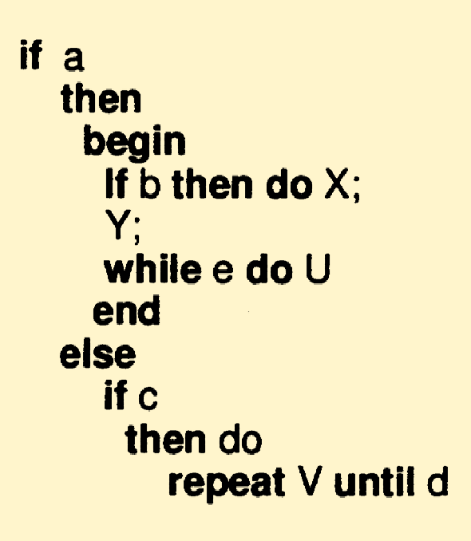
Hierarchical Measures
The decomposition tree is enough to measure a number of program characteristics, including:
Nesting factor (depth of nesting)
Structural complexity

Slide 4
Depth of Nesting
Depth of nesting α(F) for a flowgraph F can be expressed in terms of:
Primes: The depth of nesting of the prime P1 is zero, and the depth of nesting of any other prime F is equal to one. Thus, α(P1) = 0, and if F is a prime ≠ P1, then α(F) = 1.
α(P1) = 0 ; α(P2) = α(P3) = … = α(Pk) =1
α(D0) = α(D1) = α(D2) = α(D3) = 1
Sequence: The depth of nesting of the sequence F1, …, Fn is equal to the maximum of the depth of nesting of the Fis. Thus, α(F1; …; Fn) = max (α(F1); …; α(Fn)).
α(F1;F2;…;Fk) = max(α(F1), α(F2), …, α(Fk))
Nesting: The depth of nesting of the ﬂowgraph F(F1, …, Fn) is equal to the maximum of the depth of nesting of the Fi plus one because of the extra nesting level in F. Thus, α(F(F1, …, Fn)) = 1 + max(α(F1), …, α(Fn)).
α(F(F1,F2,…,Fk)) = 1+ max(α(F1), α(F2), …, α(Fk))

Slide 5
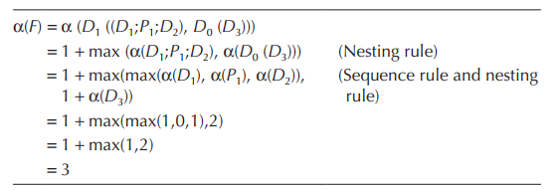
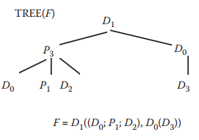
Depth of Nesting

Slide 6
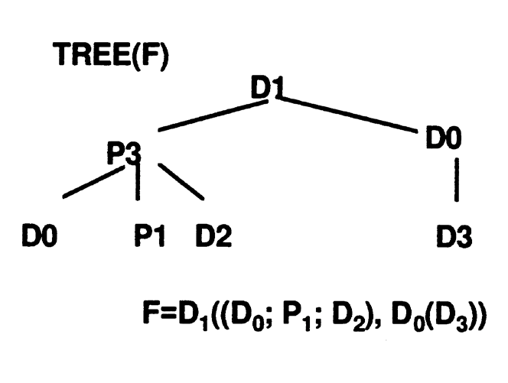
Depth of Nesting
Example:
F= D1((D0;P1;D2), D0(D3))
n(F) = 1 + max(x1, x2)
x1= max(1,0,1)
x2= 1 + max(1) = 2
n(F)= 1+ max(1,2)
n(F)= 3
Smaller depth of nesting indicates less complexity in coding and testing
x2
x1

Slide 7
Cyclomatic Complexity
A program’s complexity can be measured by the cyclomatic number of the program flowgraph.
McCabe proposed the Cyclomatic Complexity in 1976
The cyclomatic number can be calculated in 2 different ways:
Flowgraph-based
Code-based

Slide 8
Cyclomatic Complexity
For a program with the program flowgraph G, the cyclomatic complexity v(G) is measured as:
v(G) = e - n + 2
e : number of edges
Representing branches and cycles
n : number of nodes
Representing block of sequential code

Slide 9
Cyclomatic Complexity
For a program with the program flowgraph G, the cyclomatic complexity v(G) is measured as:
v(G) = 1 + d
d : number of predicate nodes (i.e., nodes with out-degree other than 1)
d represents number of loops in the graph
or number of decision points in the program
i.e., The complexity of primes depends only on the predicates (decision points or BCSs) in them.
Notes:
https://stackoverflow.com/questions/13306644/what-is-the-difference-between-cyclomatic-complexity-and-essential-cyclomatic-co

Slide 10
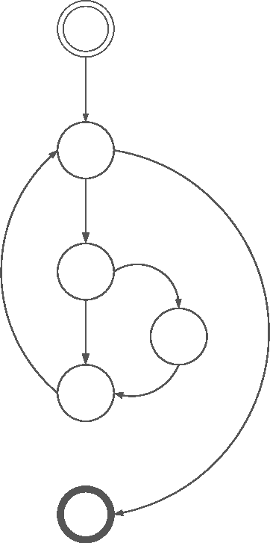
Cyclomatic Complexity: Example
v(G) = e - n + 2
v(G) = 7 - 6 + 2
v(G) = 3
Or
v(G) = 1 + d
v(G) = 1 + 2 = 3
Predicate nodes (decision points)

Slide 11
Essential Cyclomatic Complexity
McCabe also proposed a measure to capture the overall level of structuredness in a program.
For a program with ﬂowgraph F, the essential complexity eν is defined as eν(F) = ν(F) – m
where m is the number of subﬂowgraphs of F that are D-structured primes i.e., either D0, D1, D2, or D3)
McCabe asserts that the essential complexity indicates the extent to which the ﬂowgraph can be “reduced” by decomposing all those subﬂowgraphs that are D-primes.
The essential complexity of a D-structured program is one, since only a Pn is leaf after decomposing all the structured primes.

Slide 12
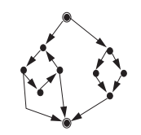
Essential Cyclomatic Complexity
Cyclomatic Complexity
v(F) = e – n + 2
= 13 - 10 + 2
= 5
Essential Cyclomatic Complexity
ev(F) = v(F) – m
= 5 – 1
= 4
m = D₁

Slide 13
Cyclomatic Complexity: Code Example
#include <stdio.h> main()
{
int a ;
scanf (“%d”, | &a);
if ( a >= 10 | )
if ( a < | 20 ) printf | ("10 < | a< | 20 | %d\n" | , | a);
else | printf | ("a >= | 20 |  | %d\n" | , | a);
else | printf | ("a <= | 10 |  | %d\n" | , | a);
}
v(G) = 1+2 = 3

Slide 14
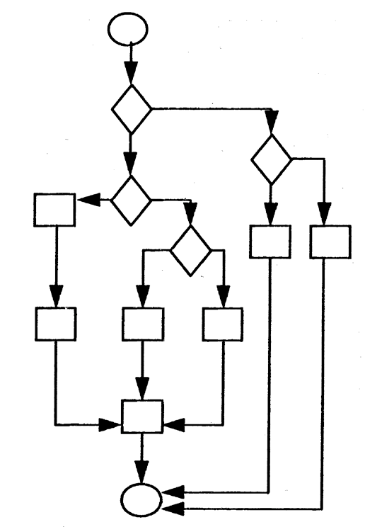
Example: Graph Based
v(G) = 16 – 13 + 2 = 5
or
v(G) = 4 +1 = 5

Slide 15
Example 1
import java.util.*;
public class CalendarTest
03. {
04. public static void main(String[] args)
05. {
// construct d as current date
GregorianCalendar d = new GregorianCalendar();
int today = d.get(Calendar.DAY_OF_MONTH);
int month = d.get(Calendar.MONTH);
// set d to start date of the month
d.set(Calendar.DAY_OF_MONTH, 1);
int weekday = d.get(Calendar.DAY_OF_WEEK);
// print heading
System.out.println("Sun Mon Tue Wed Thu Fri Sat");
// indent first line of calendar
for (int i = Calendar.SUNDAY; i < weekday; i++ )
System.out.print(" ");
do
19. {
// print day
int day = d.get(Calendar.DAY_OF_MONTH);
if (day < 10) System.out.print(" ");
System.out.print(day);
// mark current day with *
if (day == today)
System.out.print("* ");
else
System.out.print(" ");
// start a new line after every Saturday
if (weekday == Calendar.SATURDAY)
System.out.println();
// advance d to the next day
d.add(Calendar.DAY_OF_MONTH, 1);
weekday = d.get(Calendar.DAY_OF_WEEK);
35. }
while (d.get(Calendar.MONTH) == month);
// the loop exits when d is day 1 of the next month
// print final end of line if necessary
if (weekday != Calendar.SUNDAY)
System.out.println();
41. }
42. }
Determine cyclomatic complexity for the following Java program:
v = 1+d
v = 1+6 = 7

Slide 16
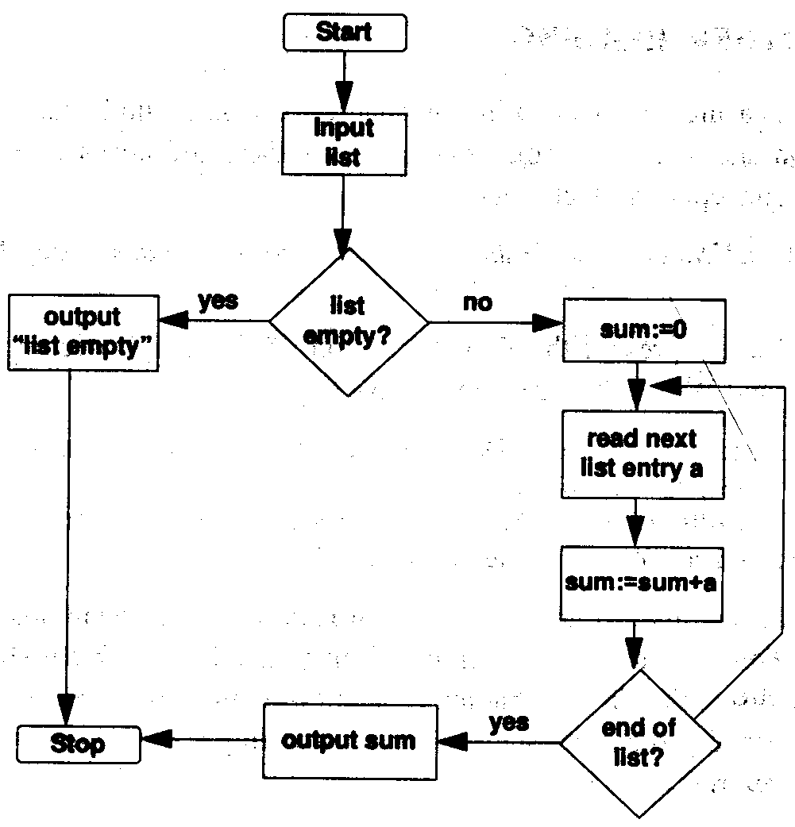
Example 2
Determine cyclomatic complexity for the following flow diagram:
v = 1+d v = 1+2 = 3
or
v = e – n + 2
v = 11 – 10 + 2 = 3

Slide 17
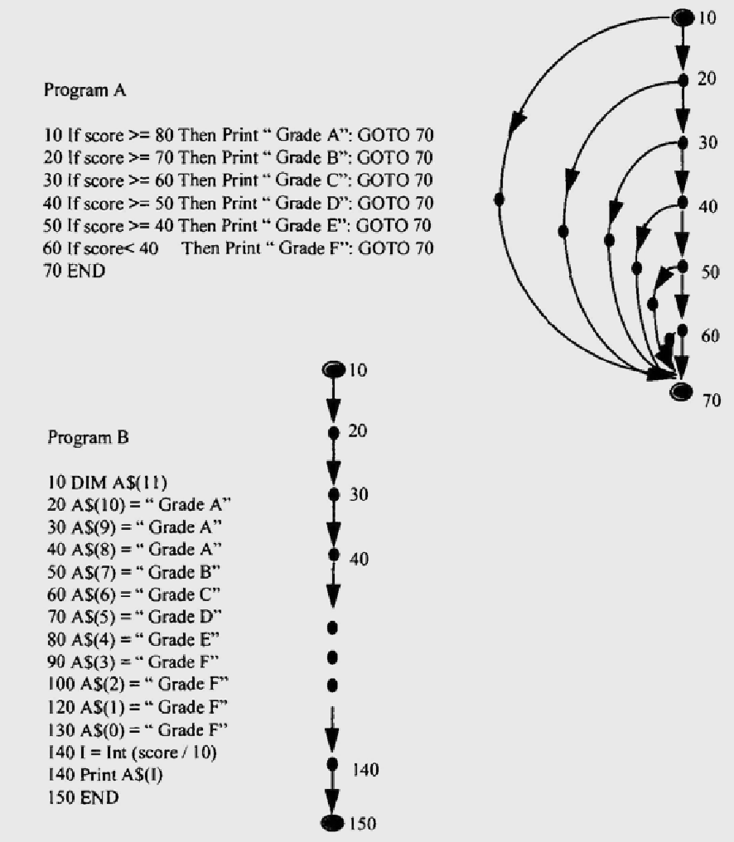
Example 3
Two functionally equivalent programs that are coded differently.
Calculate cyclomatic complexity for both
V_{A} = 7
V_{B} = 1
There is always a trade-off between control-flow and data structure. Programs with higher cyclomatic complexity usually have less complex data structure. Apparently program B requires more effort that program A.

Slide 18
Cyclomatic Complexity: Critics
Advantages:
It used as quality metrics, gives relative complexity of various designs
Objective measurement of complexity
Disadvantages:
Can only be used at the component level
Two programs having the same cyclomatic complexity number may need different programming effort
Same requirements can be programmed in various ways with different cyclomatic complexities
Requires complete design or code visibility

Slide 19
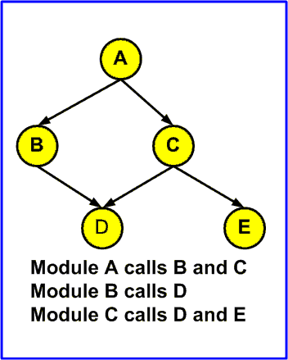
Software Architecture
Module: a module should be (at least theoretically) separately compilable. Thus, a module can be any object that, at a given level of abstraction, you wish to view as a single construct.
For example, in C, a procedure or function may be considered a module. In Java, a class or interface is considered a module.

Slide 20
Software Architecture
A software system can be represented by a graph, S = {N, R}
Each node n in the set of nodes (N) corresponds to a subsystem.
Each edge r in the set of relations (R) indicates a relation (e.g., function call, etc.) between two subsystems.
a directed graph known as the module callgraph; a call-graph is not a ﬂowgraph, as it has no circled start or stop node.

Slide 21
Morphology
Morphology refers to the overall shape of the software system architecture.
Morphological characteristics such as width and depth can then be used to describe good and bad designs.
It is characterized by:
Size: number of nodes and edges
Depth: longest path from the root to a leaf node
Width: number of nodes at any level
Edge-to-node ratio: connectivity density measure

Slide 22
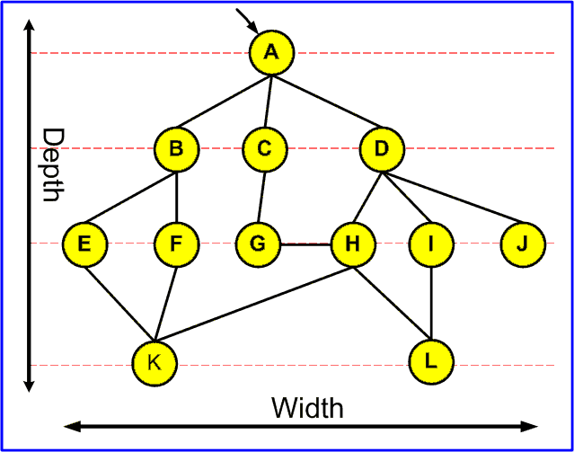
Morphology Example
Size:
12 nodes
15 edges
Depth: 3
Width: 6
e/n = 1.25

Slide 23
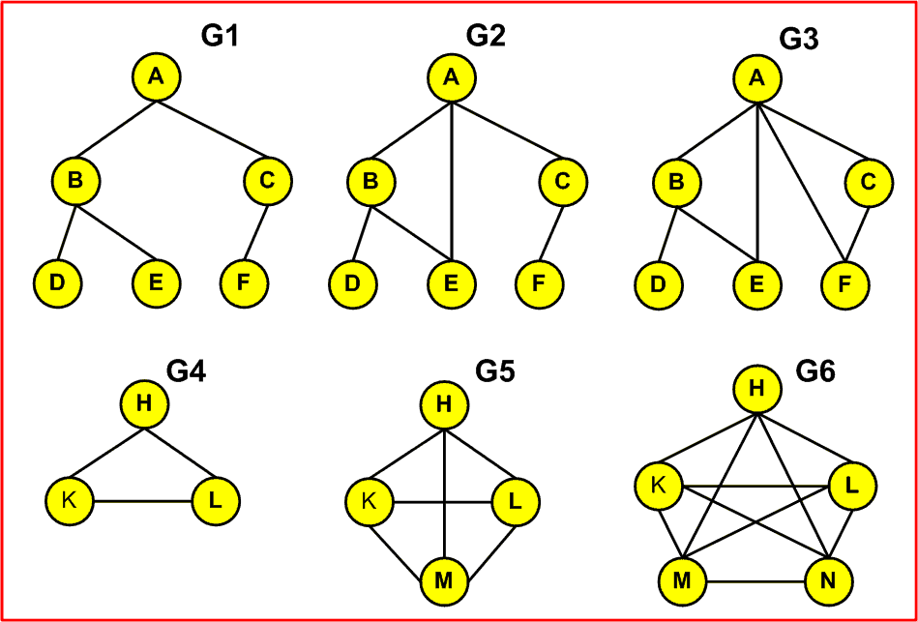
Tree Impurity
The tree impurity measures m(G) how much the graph is different from a tree
The smaller m(G) denotes the better design
Examining the tree impurity in a graph tells us much about the design. It is useful for quality assurance of designs.
Ince and Hekmatpour suggest that “The more a system deviates from being a pure tree structure towards being a graph structure, the worse the design is.”

Slide 24
Tree Impurity
B
A
C
D
F
H
G
E

Slide 25

Tree Impurity
Tree impurity can be defined as:
number of edges more than spanning tree
m(G) =
maximum number of edges more than spanning tree
Example:
m(G1) = 0 | m(G2) = 0.1 | m(G3) = 0.2
m(G4) = 1 | m(G5) = 1 | m(G6) = 1
Notes:
Complete graph
Connected graph
Spanning tree: A spanning tree is a subset of Graph G, which has all the vertices covered with minimum possible number of edges.
The maximum number of edges possible in a single graph with 'n' vertices is ^{n}C₂ where ^{n}C₂ = n(n – 1)/2
number of edges in spanning tree = n-1
Actual number of edges more than spanning tree = e – (n-1) = e – n + 1
maximum number of edges more than spanning tree = n(n-1)/2 – (n-1) = (n-1)(n-2)/2

